Slide 1
“in Jesus I found a friend”: building on the rock
Christ Our Righteousness: 2
Fred bischoff
www.Fredbischoff.com • www.aplib.org

Slide 2
review
The world we live in is immersed in a battle over two principles, eternal unselfishness (unselfish love), and temporary selfishness (selfish love).
The temporary principle had a beginning, and will have an end.
How God brings it to an end culminates in a process that matures both principles globally.
The Advent Movement’s mission is in the beginning of this transition process, also know as the Day of Atonement.

Slide 3
Understanding prophecy
Historicist method of interpreting Bible prophecy was begun by the interpretations found in the stories of Daniel
Daniel 2:19 ff regarding Nebuchadnezzar’s dream of the image
Daniel 7:16 ff regarding Daniel’s vision of the wild beasts
Daniel 8:15 ff regarding Daniel’s vision of the sanctuary animals
Daniel 10:11-14 ff regarding Daniel’s last vision, explained in chapters 11 and 12
4 Kingdoms (3 named, 1 unnamed), continued in their order “till” the transition process began that led to God’s kingdom

Slide 4
Understanding prophecy
First kingdom: Babylon (Neo-Babylonian Empire): 2 Chronicles 36 destroyed Jerusalem; Daniel served under kings: Daniel 1-5
Second kingdom: Medo-Persia: named in Daniel 8: 20; Daniel served under: Daniel 5, 6, 10
Third kingdom: Greece: named in Daniel 8:21; 11:2
Fourth kingdom: never named; but whole New Testament written under it; Rome

Slide 5
Understanding prophecy
Historicist view continued in the New Testament in the brief commentary on Daniel’s visions:
Jesus in Matthew 24
Paul in 2 Thessalonians 2

Slide 6
Understanding prophecy
Continued in the New Testament in pattern given John in Revelation:
The fourth kingdom of Daniel, how “diverse” (7:19) it would be
All in relation to God’s people (Daniel: “the saints” and “thy people” in 7:18,21,22,25,27; 8:24; 9:24; 10:14; 12:1; Revelation: church in chapters 2 and 3, and woven through rest of Revelation)
Time of transition (judgment, based in Most Holy Place of heavenly sanctuary)
Leading to God’s everlasting kingdom

Slide 7
Understanding prophecy
Method used by Christians throughout history
Gave confirmation to Protestant Reformation
Isaac Newton 1733: Observations upon the Prophecies of Daniel, and the Apocalypse of St. John
John Adams 1765: A Dissertation on the Canon and Feudal Law
See Froom’s 4 volumes The Prophetic Faith of Our Fathers
Led straight into the Advent Movement as the time began to be unsealed and fulfilled in the late 1700s into the 1800s

Slide 8
Understanding prophecy
Major events that stirred and facilitated an interest in the prophecies
Lisbon Earthquake
American Revolution and founding of the United States of America
French Revolution
General Berthier taking Pope captive
Explosion of Bible societies around the world

Slide 9
Introduction
80-year timeline, 1831-1910, tracking Jesus’ work in and through the Advent movement
Begins with William Miller’s public speaking on the prophecies of Jesus’ coming
Ends with a note about the continuing importance of past messages

Slide 10
Introduction
Pioneers: pictures of 27; 10 others mentioned; most ”first generation” (alive in 1844)
Biographical sketches, summaries, video/audio lectures available at www.APLib.org
Many were authors; their books, pamphlets, and some periodical writings are available in the Adventist Pioneer Library section of Ellen White’s collection online (www.EGWWritings.org) and in her desktop and mobile apps; Adventist Pioneer Library has reprinted and translated some books which we will highlight

Slide 11
Introduction
Messages: series of 6 Bible passages beginning in a historical sequence, having special application: 4 for the world, and 2 especially for the messengers
Landmarks: 7 immovable Bible concepts connected to the messages (similar metaphors: foundations, waymarks)
Ministries: 5 activities used to spread the messages

Slide 12
Introduction
Time: dates related to the message and mission: time prophecy, general chronology, and delay
History
Tour guide: will use Ellen White (eyewitness, messenger) mainly
Importance: decreasing or increasing
Timeline
First 24 pioneers: pre-1844 year they joined the Advent Movement, or post-1844 years they accepted the Third Angel’s Message
Last 3 pioneers: note them on special year tied to the final message

Slide 13
Introduction
Part 2: 1830s and 1840s: “In Jesus I Found a Friend”
Part 3: 1850s - 1880s: “Righteousness Outside the Door”
Part 4: 1890s: “Righteousness Intensely Practical”
Part 5: 1900-1903: “Righteousness Counterfeited”
Part 6: 1904-1910: “Righteousness in Remission”

Slide 14
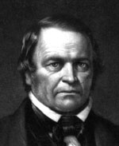
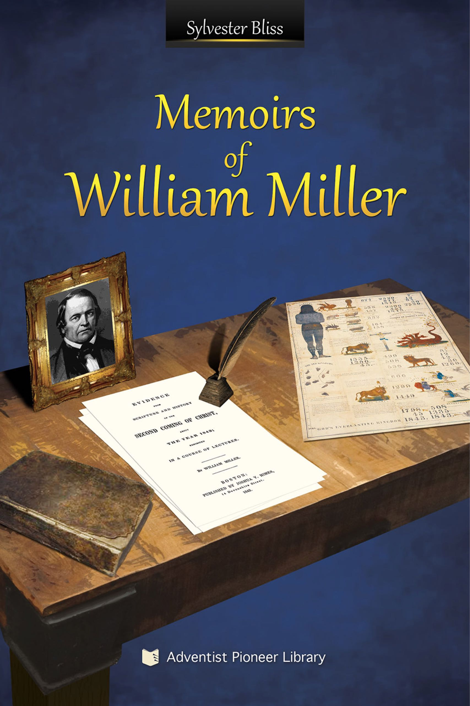
1831
William Miller (1782-1849)
Farmer, Deist then Baptist; “In Jesus I found a friend.” Studies Bible, prophecies. Pressured to share, begins 1831
Message: First Angel’s Message (Revelation 14:6, 7)
Landmark: Second Coming: Jewish year 1843-1844, Daniel 8:14
Ministries: Meetings and Publishing
Book: Memoirs of William Miller

Slide 15
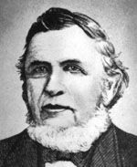
1838
Josiah Litch (1809-1886)
Preacher; Methodist Episcopal
Accepts Second Coming after reading Miller’s lectures
June 1838: Points to August 11, 1840 as fall of Ottoman Empire (Revelation 9:15)

Slide 16
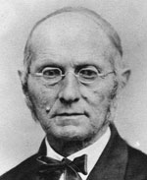
1839
Joseph Bates (1792-1872)
Retired sea captain; Christian Church; temperance work
Accepts Second Coming when reads Miller’s lectures
1846: Landmark of Sabbath: writes tract: The Seventh Day Sabbath, A Perpetual Sign
Book: Autobiography of Elder Joseph Bates (also Portuguese, Spanish)

Slide 17
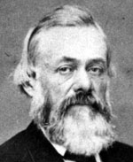
1839
Joshua Himes (1805-1896)
Preacher; Christian Church
Accepts Second Coming hearing Miller’s lectures
Becomes Advent publicist, publisher (many publications; in 1840 begins Signs of the Times weekly periodical; 1842 The Midnight Cry daily periodical for first month, then weekly)

Slide 18
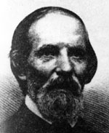
1839
Samuel Snow (1806-1890)
Writer; infidel
Converted reading Miller’s lectures, accepts Second Coming
August 1844: key study of evidences pointing to 10th day of 7th month (October 22, 1844), leading to the Seventh-Month Movement or Midnight Cry

Slide 19
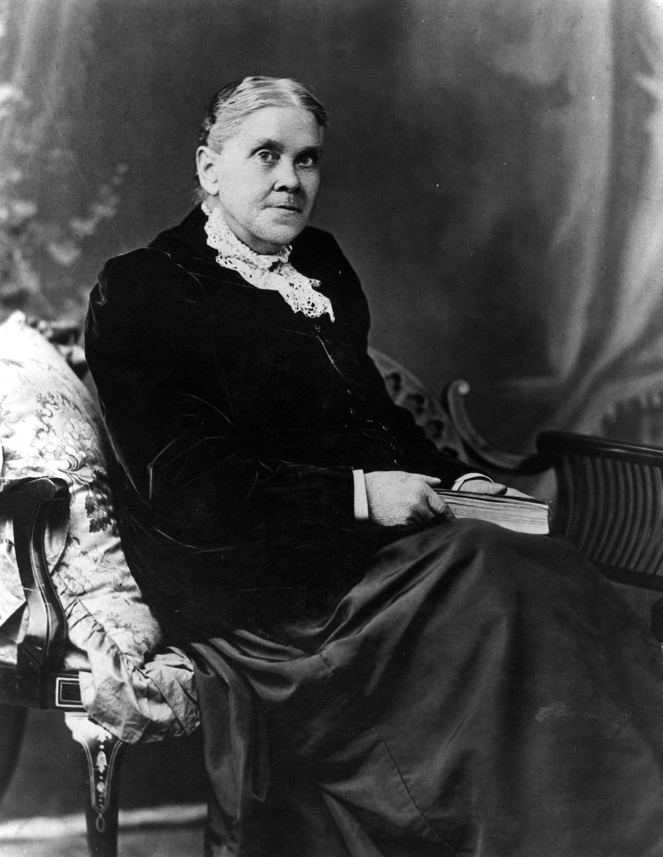
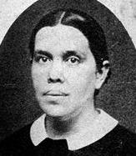
1840
Ellen Harmon (1827-1915)
Family and she accepts Second Coming after hearing Miller the year she turned 13; family Methodist
December 1844: became “messenger of the Lord”, conveying the testimony of Jesus
Resources; www.EllenWhite.org; www.EGWwritings.org

Slide 20
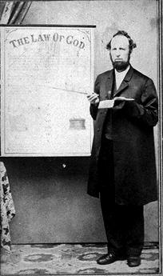
1841
James White (1821-1881)
School teacher; Christian Church
Joins Millerites, accepting Second Coming, age 20
1846: married Ellen Harmon, accepts landmark of Sabbath
1849: begins Sabbath-keeping Adventist publishing; key figure in Third Angel’s Message, and preaching the landmark of the Law of God
Books: A Word to the Little Flock; and Life Incidents (also Portuguese)

Slide 21
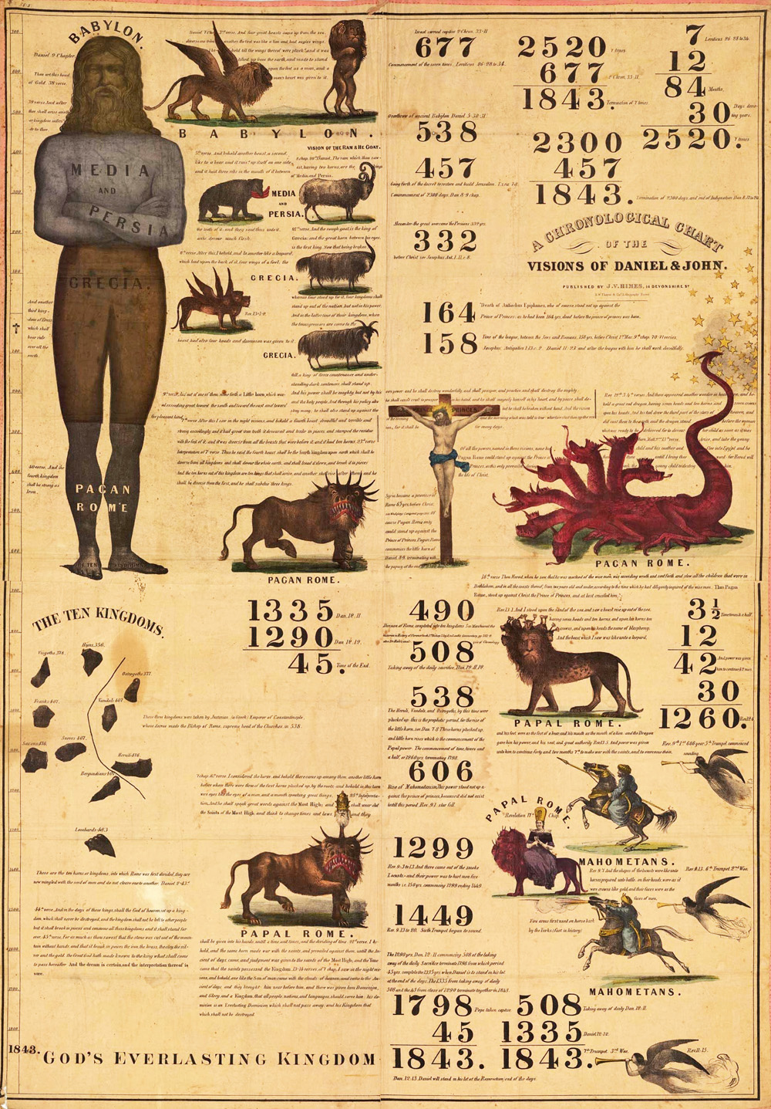
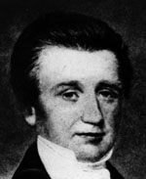
1841
Charles Fitch (1805-1844)
Preacher; Presbyterian
Focus on holiness/sanctification
Joins Millerites after accepting the Second Coming
1842: helps develop prophetic chart
1844: Key figure in Second Angel’s Message; died October14

Slide 22
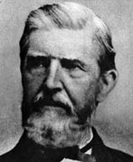
1842
George Storrs (1796-1879)
Preacher; former Methodist
Focus on Landmark of non-immortality of wicked; had already published on it
Hears Second Coming, accepts and invited Fitch to preach

Slide 23
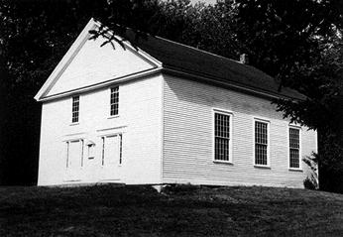
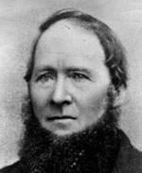
1842
William Farnsworth (1807-1888)
Farmer; Christian Church
Builds Washington New Hampshire church building; hears and accepts Second Coming
1844: Rachel Oaks, Seventh-day Baptist, leads minister Frederick Wheeler to accept Sabbath; T. M. Preble also begins keeping Sabbath, and in 1845 writes A Tract Showing That the Seventh Day Should be Observed as the Sabbath which leads Joseph Bates to accept it

Slide 24
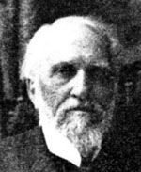
1843
O. R. L. Crosier (1820-1913)
Teacher; Methodist
Hears and accepts Second Coming in the Millerite message, and began preaching
1844 & 1845: key person in developing the landmark of the Cleansing of the Sanctuary

Slide 25
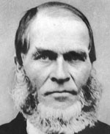
1843
Hiram Edson (1806-1882)
Farmer; Methodist
Hears and accepts Second Coming from Himes and Fitch
1844 & 1845: other key person in developing the landmark of the Cleansing of the Sanctuary
1846: conference with Joseph Bates, exchanging Sabbath and Sanctuary landmarks

Slide 26
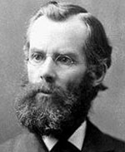
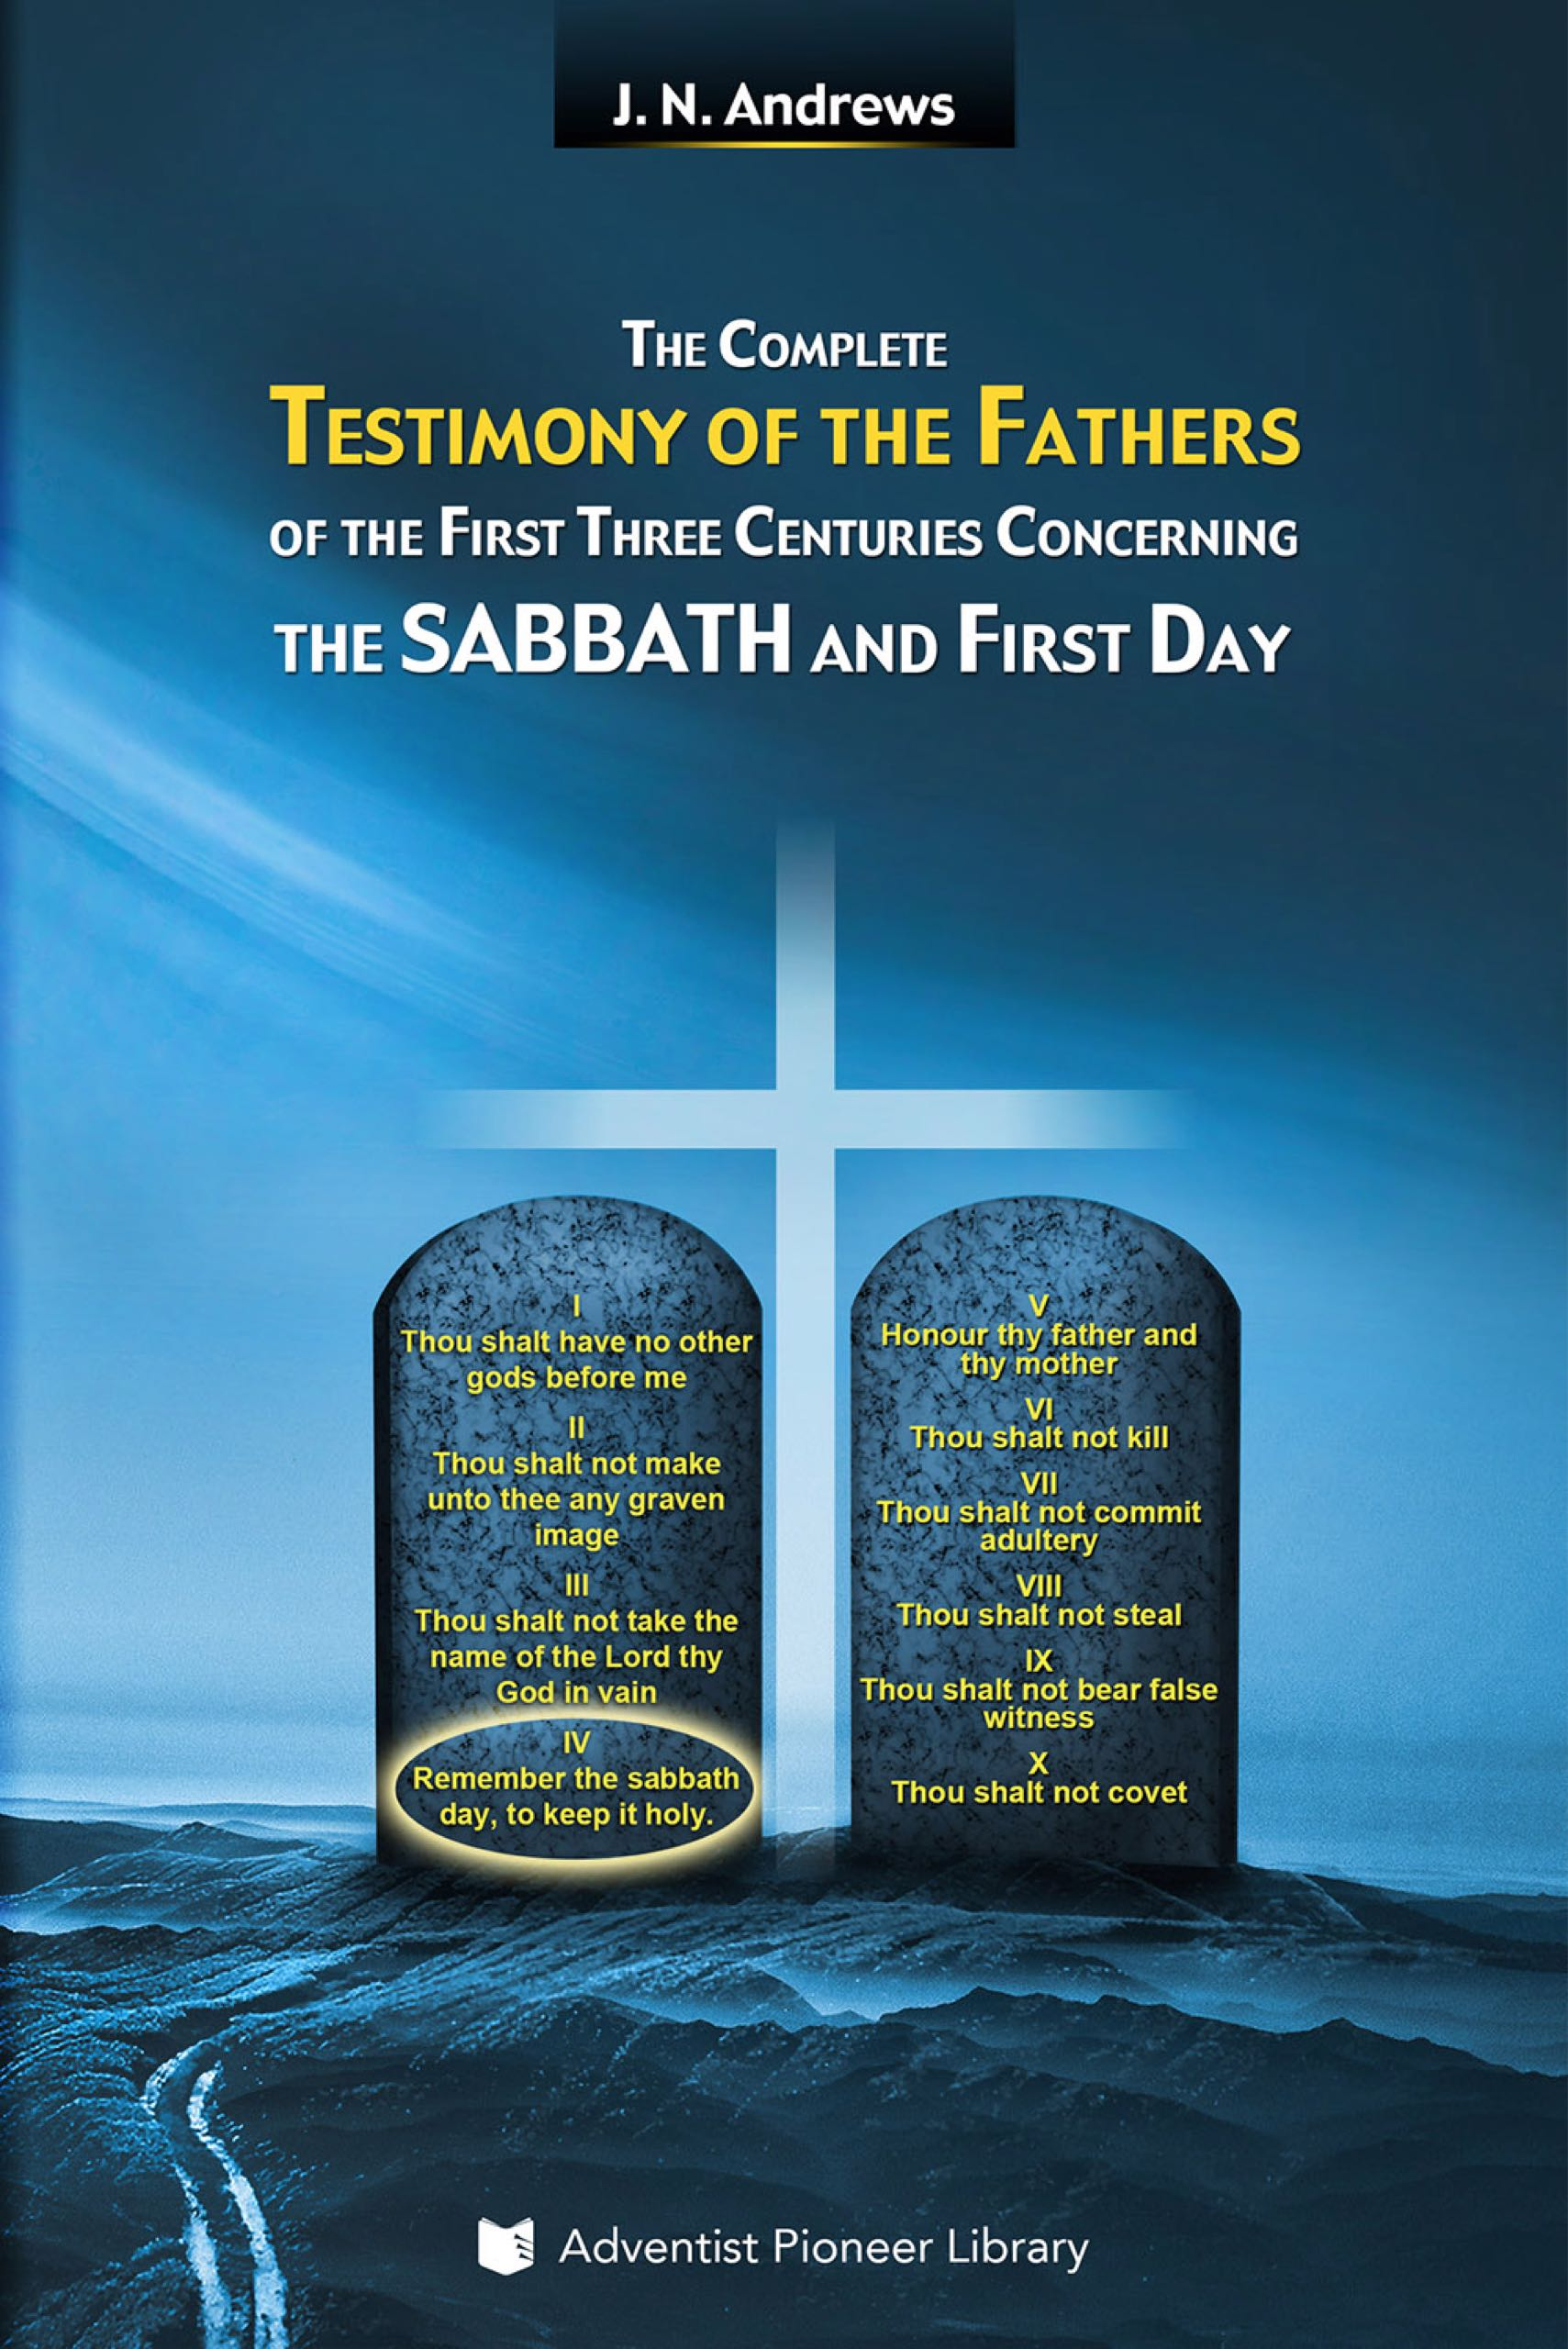
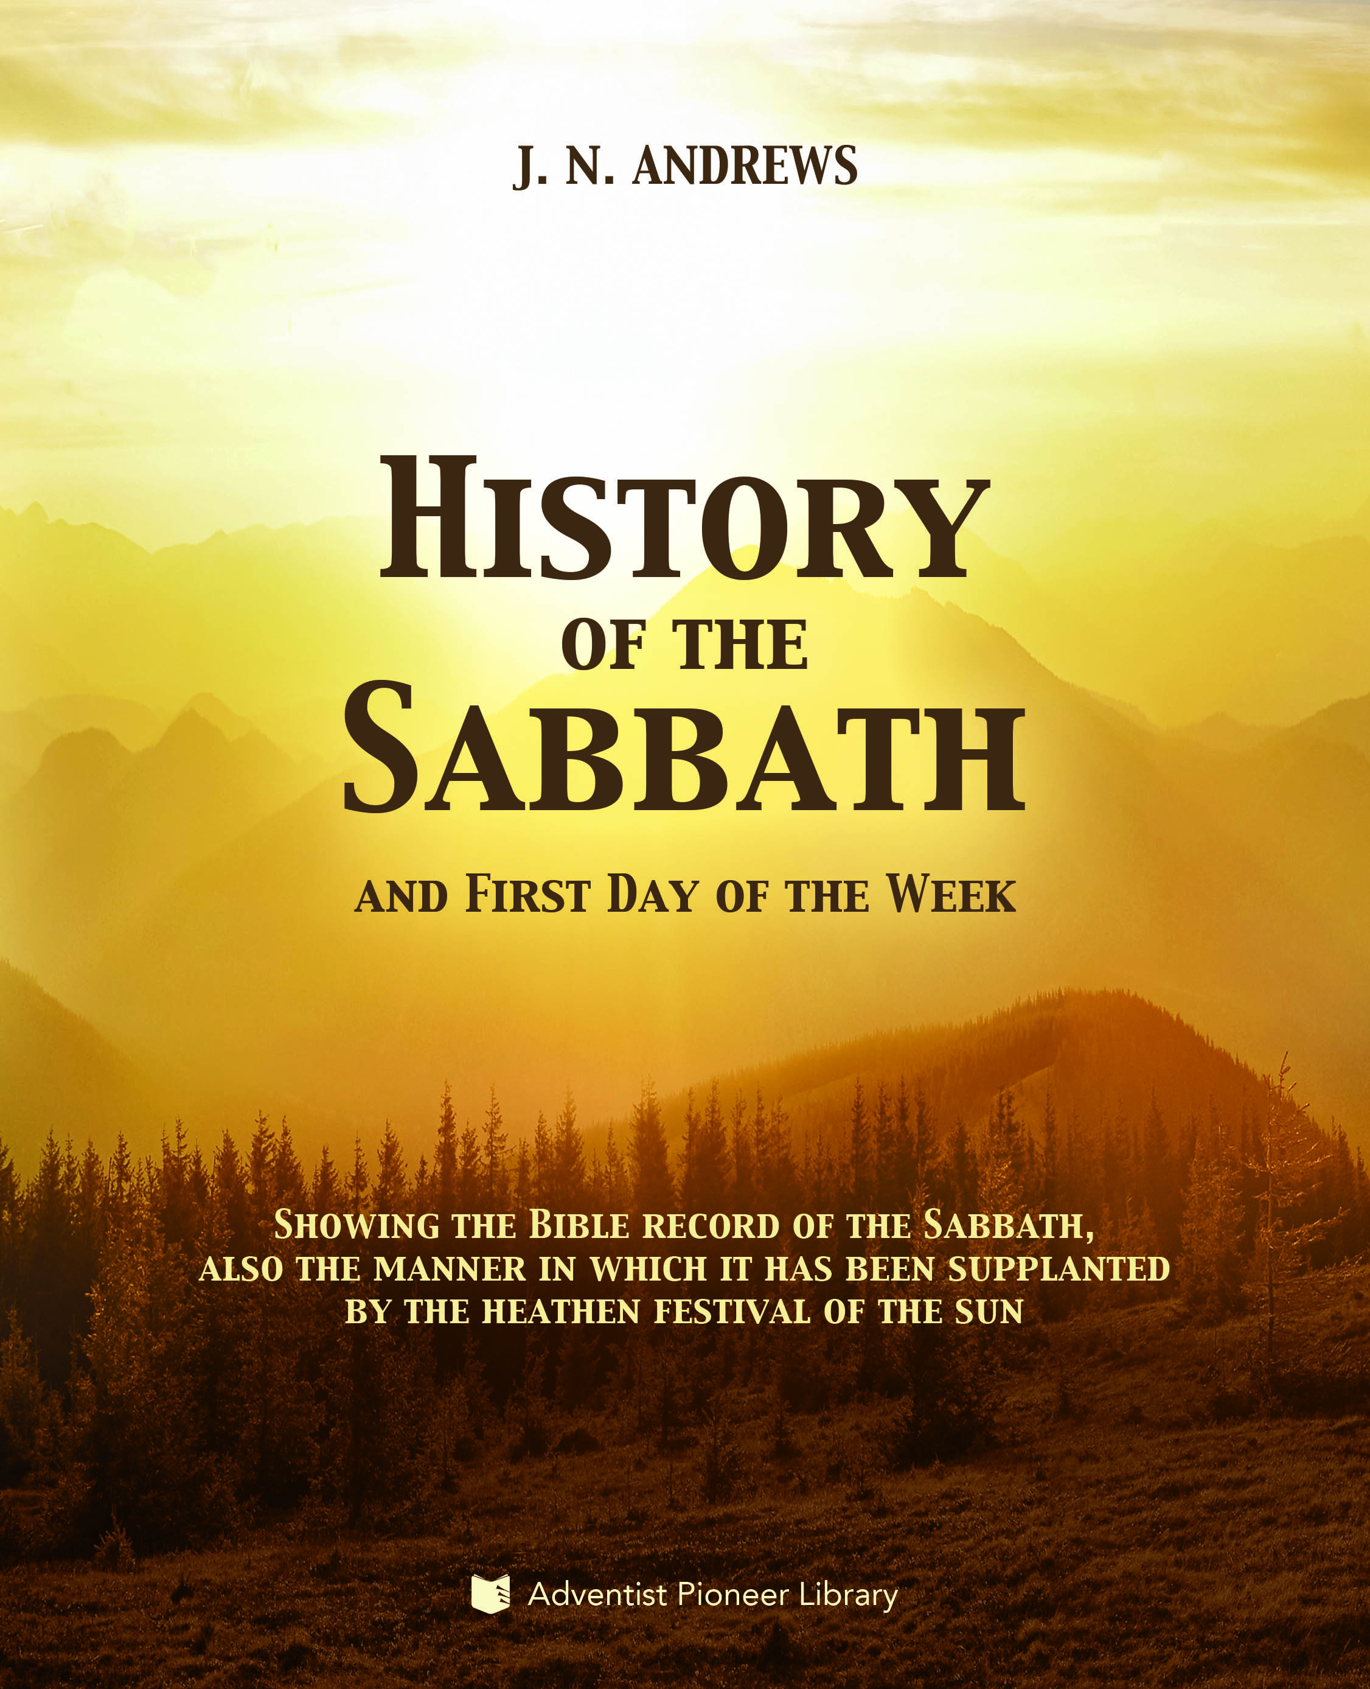
1843
J. N. Andrews (1829-1883)
Teenager; accepts Second Coming in Millerite teaching
1845: accepted landmark of Sabbath after reading Preble’s tract; later did major research on the Sabbath
Author, administrator, missionary
Books: History of the Sabbath and First Day of the Week; and The Complete Testimony of the Fathers of the First Three Centuries Concerning the Sabbath and First Day

Slide 27
1844
Spring, First Disappointment regarding Second Coming of Jesus (end of Jewish year)
Summer: Second Angel’s Message (Revelation 14:8) sounded
Late summer: Midnight Cry Message (Matthew 25:1-13) sounded, like Tidal Wave, pointing to October 22
October 14: Charles Fitch dies
October 22: the “passing of the time”; “Great Disappointment”

Slide 28
1844
October: Third Angel’s Message (Revelation 14:9-12) begins (joining the First and Second Angel, and the Midnight Cry)
December: Ellen Harmon’s first vision
This message, and this messenger will be closely connected with what God does for the rest of the time we will review

Slide 29
1844
6 of the early leaders do not continue into the light of the Third Angel’s Message
William Miller
Josiah Litch
Joshua Himes
Samuel Snow
George Storrs
O. R. L. Crosier

Slide 30
1844
Landmarks tied to Second Coming began coming together, studied over the next 4 or 5 years:
Cleansing of the Sanctuary (Crosier, Edson)
Three Angel’s Messages (1:Miller; 2:Fitch; 3:White)
Commandments of God (White)
Faith of Jesus (neglected)
Sabbath (Farnsworth, Bates)
Non-immortality of the Wicked (Storrs)

Slide 31
1847
William Miller’s Dream (box with jewels and coins)
Encouragement: he had done what God wanted him to do
Confusion after the disappointment was now out of his hands
God would have to take over and would develop a message and people 10x as glorious
In Ellen White’s Early Writings, and James White’s Brother Miller’s Dream
Millerite Adventist periodicals stop printing anything from the Sabbath-keeping Adventists

Slide 32
1848
Ellen White: vision that James should start his own publishing ministry
Important Bible conferences to study the landmark truths

Slide 33
1849
July: James White begins The Present Truth periodical; a year later he would add The Advent Review, then launch a combined journal, Second Advent Review, and Sabbath Herald, in which he would use the imagery from Miller’s dream to describe the intent of the publication.
December: William Miller dies

Slide 34
Summary 1830 - 1849
Early Adventists followed the Historicist method of interpreting Bible prophecy
As the time elements were unsealed when their fulfillments arrived, they helped fuel the Advent Movement, which became a decision time and shaking for Christianity
The disappointment of 1844 became a shaking time for the Advent Movement itself

Slide 35
Summary 1830 - 1849
The disappointment of 1844 is best understood in light of the parallels with Daniel 8 and 9; consider briefly:
Fulfillment of Daniel 9’s time occurred in New Testament
When time came for fulfillment of Daniel 9’s time elements, God raised up John the Baptist, whose preaching led to Jesus and His disciples, themselves preaching “the time is fulfilled” (Mark 1:15; compare Matthew 3:2; 4:17; 10:7), with 5 key developments:

Slide 36
Summary 1830 - 1849
1: The First Advent Movement was the final call to Israel
2: The disciples did not understand Messiah’s main sanctuary focus then: lamb slain in the “courtyard”
3: The cross was their “great disappointment”
4: Deeper understanding of prophecy: Jesus in Luke 24
5: Follow Jesus by faith as He was installed as the High Priest / King in the heavenly sanctuary (Acts 2; Hebrews 5)

Slide 37
Summary 1830 - 1849
Fulfillment of Daniel 8’s time occurred in 1844
When time came for fulfillment of Daniel 8’s time elements, God raised up the Advent Movement, preaching “the hour of His judgment is come” (Revelation 14:7), with a parallel of 5 similar key developments:

Slide 38
Summary 1830 - 1849
1: The Second Advent Movement is the final global call
2: The believers did not understand Messiah’s main sanctuary focus then: move into the Most Holy Place
3: 1844 their “great disappointment”
4: Deeper understanding of prophecy: Day of Atonement
5: Follow Jesus by faith as He moved into the Most Holy Place in the heavenly sanctuary (Revelation 11:19)

Slide 39
Summary 1830 - 1849
Out of this shaking for the Advent Movement itself, a small group began to learn to follow Jesus in the Day of Atonement activities
Christ our righteousness in the Most Holy Place = better understanding of sanctuary message, law of God, Sabbath; but missed the significance of the blood on the gold in the Most Holy Place, the most important symbol of righteousness there; we will trace this…

Slide 40
Thought question
Can you see better how the prophecies of Daniel and Revelation point to the vital key points in Jesus’ sanctuary ministry?

