Slide 1
Righteousness outside the door: early opportunities lost
Christ Our Righteousness: 3
Fred bischoff
www.Fredbischoff.com • www.aplib.org

Slide 2
Review
Advent movement began in answer to the time prophecies, thought at first to point to Jesus’ Second Coming. A growing understanding of the Cleansing of the Sanctuary pointed instead to the beginning of the Day of Atonement. Jesus as High Priest was taking His blood into the Most Holy Place, starting a process of transition that would bring the temporary principle of selfishness to an end in the great controversy.

Slide 3
Review
By the end of the 1840s, 4 messages were sounding, and all 7 landmarks were in place (though one was very neglected). The two main ministries, meetings and publishing, were continuing, now within the “little flock” of Sabbath-keeping Adventists who were following the light of the Midnight Cry, into a developing understanding of the Third Angel’s Message. We’ve seen 13 individuals involved in the early years.

Slide 4
Preview
In this next section covering the 1850s to the 1880s, we see how God continued to lead and teach as we add 14 more individuals, as well as the beginning of the last 2 messages, and 3 more ministries.

Slide 5
Preview
We will also begin to trace the negative effects of unbelief, one of the worst consequences of the principle of selfishness. (Compare Jesus’ disciples’ unbelief and its results in Matthew 17:20; Matthew 26:56; Mark 16:14.)

Slide 6
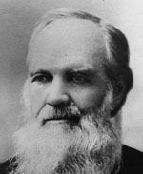
1851
J. H. Waggoner (1820-1889)
Publisher, editor; Baptist
Hears and accepts the Third Angel’s Message, and in 1853 is devoting himself to it
1866: key statement of support for visions of Ellen White, and work of health reform
Editor, author

Slide 7
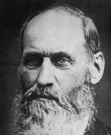
1851
R. F. Cottrell (1814-1892)
Teacher; Seventh Day Baptist
Believed the Second Coming but not the judgment hour message because the Millerites were not observing the Sabbath
Accepts Third Angel’s Message, publishes poem on the Sabbath, “It’s Jewish”
Writer, preacher, administrator; at first opposed organizing into a church

Slide 8
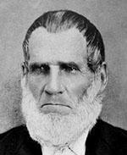
1852
Stephen Pierce (1804-1883)
Baptist
Participated in the Bible conferences 1848+ on landmarks
Accepts Third Angel’s Message
Editor, administrator
Processing “the law in Galatians” (wrote on it) and “the faith of Jesus” (asked Ellen White)

Slide 9
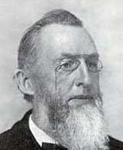
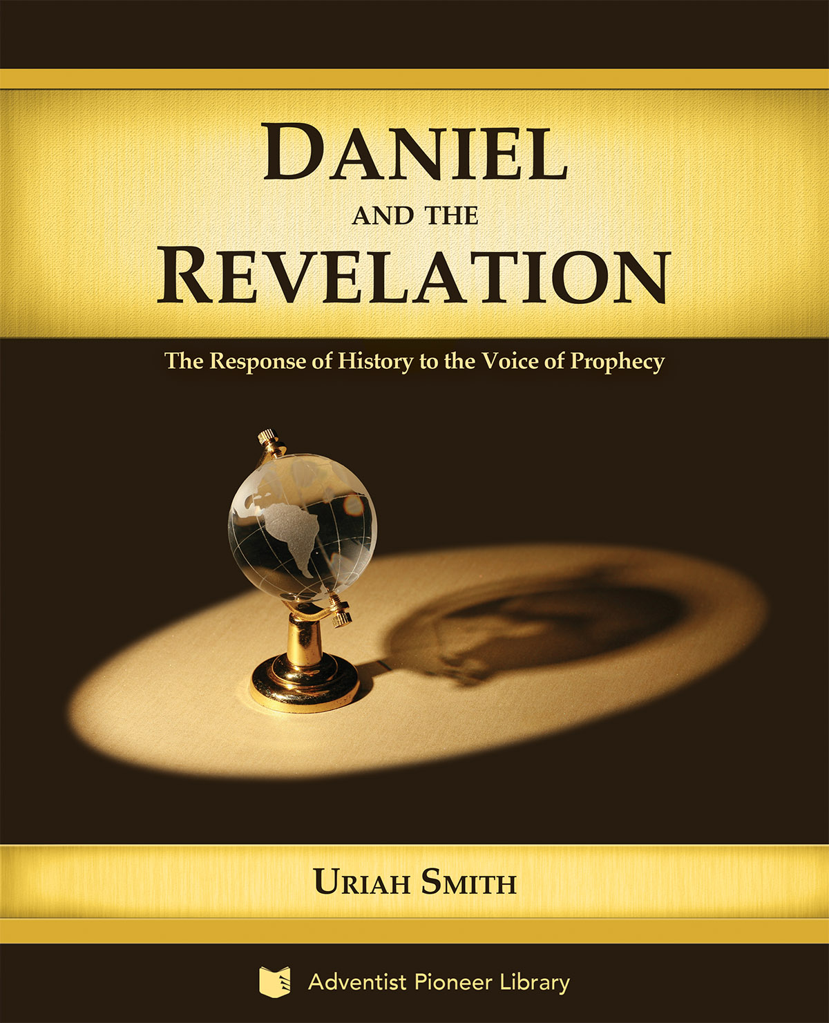
1852
Uriah Smith (1832-1903)
Mother an Advent believer; he had interest in it as child, but not as teenager
Attends Bible Conference, hears Third Angel’s Message, studies, accepts it; 1853: joins the Review staff
Editor, author, poet, engraver, inventor, administrator
Book: Daniel and the Revelation

Slide 10
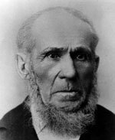
1852
John Byington (1798-1887)
Farmer/preacher; Methodist Episcopal Church
Accepts Third Angel’s Message after reading Review
1855: helped build first church for Sabbath-keeping Adventists
Visiting pastor, counselor, administrator (first General Conference president)
Permitted to live almost 90 years through “the time of the end”

Slide 11
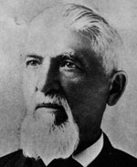
1852
M. E. Cornell (1827-1893)
Teenage believer in Second Coming, dedicated to preaching the Advent
Accepts Third Angel’s Message after hearing Joseph Bates at a Sabbath Conference; becomes an evangelist
1854: with Loughborough conducted the first Sabbath-keeping Adventist tent meeting
Author

Slide 12
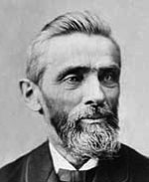
1852
J. N. Loughborough (1832-1924)
Raised by grandfather who was a believer in Second Coming; surrendered to Jesus age 16 and began preaching
Accepts Third Angel’s Message after hearing J. N. Andrews present the Sabbath and sanctuary, matching a dream he had
Evangelist, administrator, author (more later)

Slide 13
1852
Laodicean Message (Revelation 3:14-22) applied to Adventists by Ellen White (earlier brief mention in 1850).
1856: applied by James White to Sabbath-keeping Adventists

Slide 14
Laodicean message
1857: “The testimony to the Laodicean church was generally received; but some in the East were making bad use of it. … These things have had a blighting influence, and have caused us to lay down our testimony on the subject almost entirely.” {2SG 222.1}
“The design of the message to the Laodiceans was to rid the church of just such fanatical influences; but the effort of Satan has been to corrupt the message, and destroy its influence.” {222.2}

Slide 15
Laodicean message
“I saw that the testimony to the Laodiceans applied to God's people at the present time, and the reason it has not accomplished a greater work, is because of the hardness of their hearts.… When it was first presented, it led to close examination of heart. Sins were confessed, and the people of God were stirred everywhere…. “

Slide 16
Laodicean message
“I saw that this message would not accomplish its work in a few short months. It was designed to arouse the people of God, to discover to them their backslidings, and lead to zealous repentance, that they might be favored with the presence of Jesus, and be fitted for the loud cry of the third angel.” {2SG 223.2}
This 5th message joined the Three Angels’ Messages and the Midnight Cry; like that Cry, it was a message for the messengers, to accomplish those four things, leading to the final message.

Slide 17
Laodicean message
Who is the message from?
Where does He picture Himself in the message?
What is He doing? (see Song of Solomon 5:2)
What does He want to do?
What does He want us to do?
If He is our righteousness, what are we without Him?

Slide 18
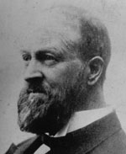
1853
George Amadon (1832-1913)
Raised by grandfather who owned a tavern
Accepts Third Angel’s Message after hearing J. N. Loughborough present the present truth
Printer, writer, editor, administrator

Slide 19
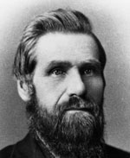
1853
S. N. Haskell (1833-1922)
Soap maker, farmer; Congregational Church
Accepts Sabbath (from a tract) a year after hearing an Advent sermon and beginning to preach; the following year met Bates who shared all the Third Angel’s Message
Evangelist, administrator; started Tract and Missionary Society; founded school; missionary
Book: The Cross and Its Shadow

Slide 20
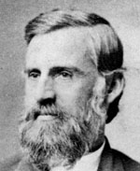
1856
G. I. Butler (1834-1918)
Family Baptist and part of Millerite movement; 1848 and 1850 parents accepted Sabbath
Infidel teenager; converts and baptized by J. N. Andrews
Administrator (General Conference president at time of Minneapolis Session in 1888)

Slide 21
1858
March: Ellen White has the Great Controversy vision; in section on Advent Movement:
Looked back: Don’t “move a block or stir a pin” (metaphors of a building) {EW 258.3}
Looked forward: A message coming: the earth would be “lightened with his glory” {EW 277.1}

Slide 22
1860
September 29: In a business meeting resolutions are made to adopt the beginning steps of a new ministry called Organization: names chosen of “Advent Review Publishing Association” and “Seventh-day Adventists” (Ellen G. White, Biography Volume 1, pages 421-424)

Slide 23
1861
October 5: In another business meeting resolutions are made to “associate ourselves together as a church, taking the name Seventh-day Adventists” and that “the churches in the State of Michigan to unite in one conference with the name of the Michigan Conference of Seventh-day Adventists” (Ellen G. White, Biography Volume 1, pages 454-455).

Slide 24
1863
May 20: General Conference is formed; John Byington first president (Ellen G. White, Biography Volume 1, page 479; Volume 2, pages 31, 32).
June 3: Vision on Health, seeds of another new ministry (Ellen G. White, Biography Volume 2, page 11.1).
In the ministry of meetings, preaching and teaching had always been done, as well as prayer for the sick. Now the third element of Jesus’ work (Matthew 4:23) was being grasped at a deeper level—the causes of disease. Which of these three ministry activities was Jesus’ major one?

Slide 25
1866
May 22: General Conference adopts Health Reform resolution (Ellen G. White, Biography Volume 2, page 136.2).
July 20: J. H. Waggoner makes statement on Health Reform. (See under Reference section.)
September 5: Western Health Reform Institute opens. (Ellen G. White, Biography Volume 2, page 142.2&3; 176.3)
Can you see another way we are heirs of the Reformation—that reforms must continue?

Slide 26
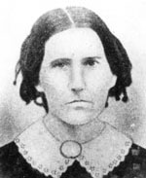
1867
Rachel Preston (1809-1868)
Seventh-day Baptist, and connected to the Millerite movement, spreading the Sabbath in 1844
Accepts the Third Angel’s Message (other landmarks)

Slide 27
1868
June 12: “So many would be found unready”; “so long delay” (Pamphlet Number 98 [PH098], p. 16.2; also Testimonies for the Church, Volume 2, page 193.3; may be earliest statement on DELAY).
Rachel Preston dies.

Slide 28
1872
Joseph Bates dies (Ellen G. White in Europe, D. A. Delafield, page 34.1).
June 3: Education: opening of first school (Ellen G. White, Biography Volume 2, page 338.5&6). This ministry was being formalized and institutionalized.

Slide 29
1874
September: J. N. Andrews to Europe as first official missionary. (Ellen G. White, Biography Volume 2, page 447.7)

Slide 30
1876
Events in this year highlight the role of the study of nature (science) and the Creator. The Advent Movement has been given the elements of an entire lifestyle centered around the Creator. This includes education and research in all the sciences, and the practices that flow out of these. Health and medicine are central examples of these activities. The year 1876 also illustrates, in contrast, the counterfeit philosophies with their methods of science and living. (See syllabus for further study.)

Slide 31
1878
J. N. Loughborough’s experience of value (The Great Second Advent Movement, J. N. Loughborough, pages 484, 485, quoting Ellen White).

Slide 32
1881
James White dies (Life Sketches, page 470.4). In his last days, the part of the story he realized needed more central emphasis was “the glorious subject of redemption” (Ibid. page 247.2). In other words, the work in the Most Holy Place (the final judgment) needed the blood from the courtyard (the reality and benefits of the cross of Jesus).

Slide 33
1882
Hiram Edson dies.

Slide 34
1883
J. N. Andrews dies (Ellen G. White, Biography Volume 3, page 296.1)
Stephen Pierce dies.

Slide 35
1883
If early Adventists (after 1844) had accepted “the message of the third angel and in the power of the Holy Spirit proclaimed it to the world”, “Christ would have come ere this” “Unbelief, murmuring, and rebellion”, “worldliness, unconsecration, and strife” “have kept us in this world of sin and sorrow so many years” (Selected Messages, Volume 1, pages 68.1 to 69.1; DELAY). This alludes to the neglected landmark.

Slide 36
1886
November: Loud Cry beginning:
“Said my guide, ‘There is much light yet to shine forth from the law of God and the gospel of righteousness. This message, understood in its true character, and proclaimed in the Spirit, will lighten the earth with its glory. (The Ellen G. White 1888 Materials, page 166.1; hereafter, abbreviated EGW1888).

Slide 37
1887
John Byington dies.

Slide 38
1888
October, November: Minneapolis General Conference. See The Ellen G. White 1888 Materials in the Ellen White writings, Miscellaneous Collections section (documents from 1887 to 1910). See also Manuscripts and Memories of Minneapolis in the Adventist Pioneer Library, Miscellaneous Titles (Ellen G. White Estate). “Justification by faith and the imputed righteousness of Christ”— the Loud Cry Message joins “the faith of Jesus” with “the commandments of God” (EGW1888, pp. 1136.2; 1073.7; compare page 217.3 “the law and the gospel going hand in hand”). See Revelation 14:12!

Slide 39
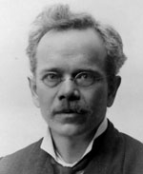
1888
E. J. Waggoner (1855-1916)
Son of J. H. Waggoner, converted 1882 (age 27). Co-editor of The Signs of the Times.
Messenger of righteousness of Jesus (EGW 1888, pages 174.3; 211.2; 217.2; 1336.2; 1455.2; 1814.4).
Article collection: Lesson on Faith republished

Slide 40
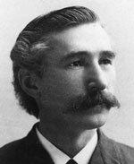
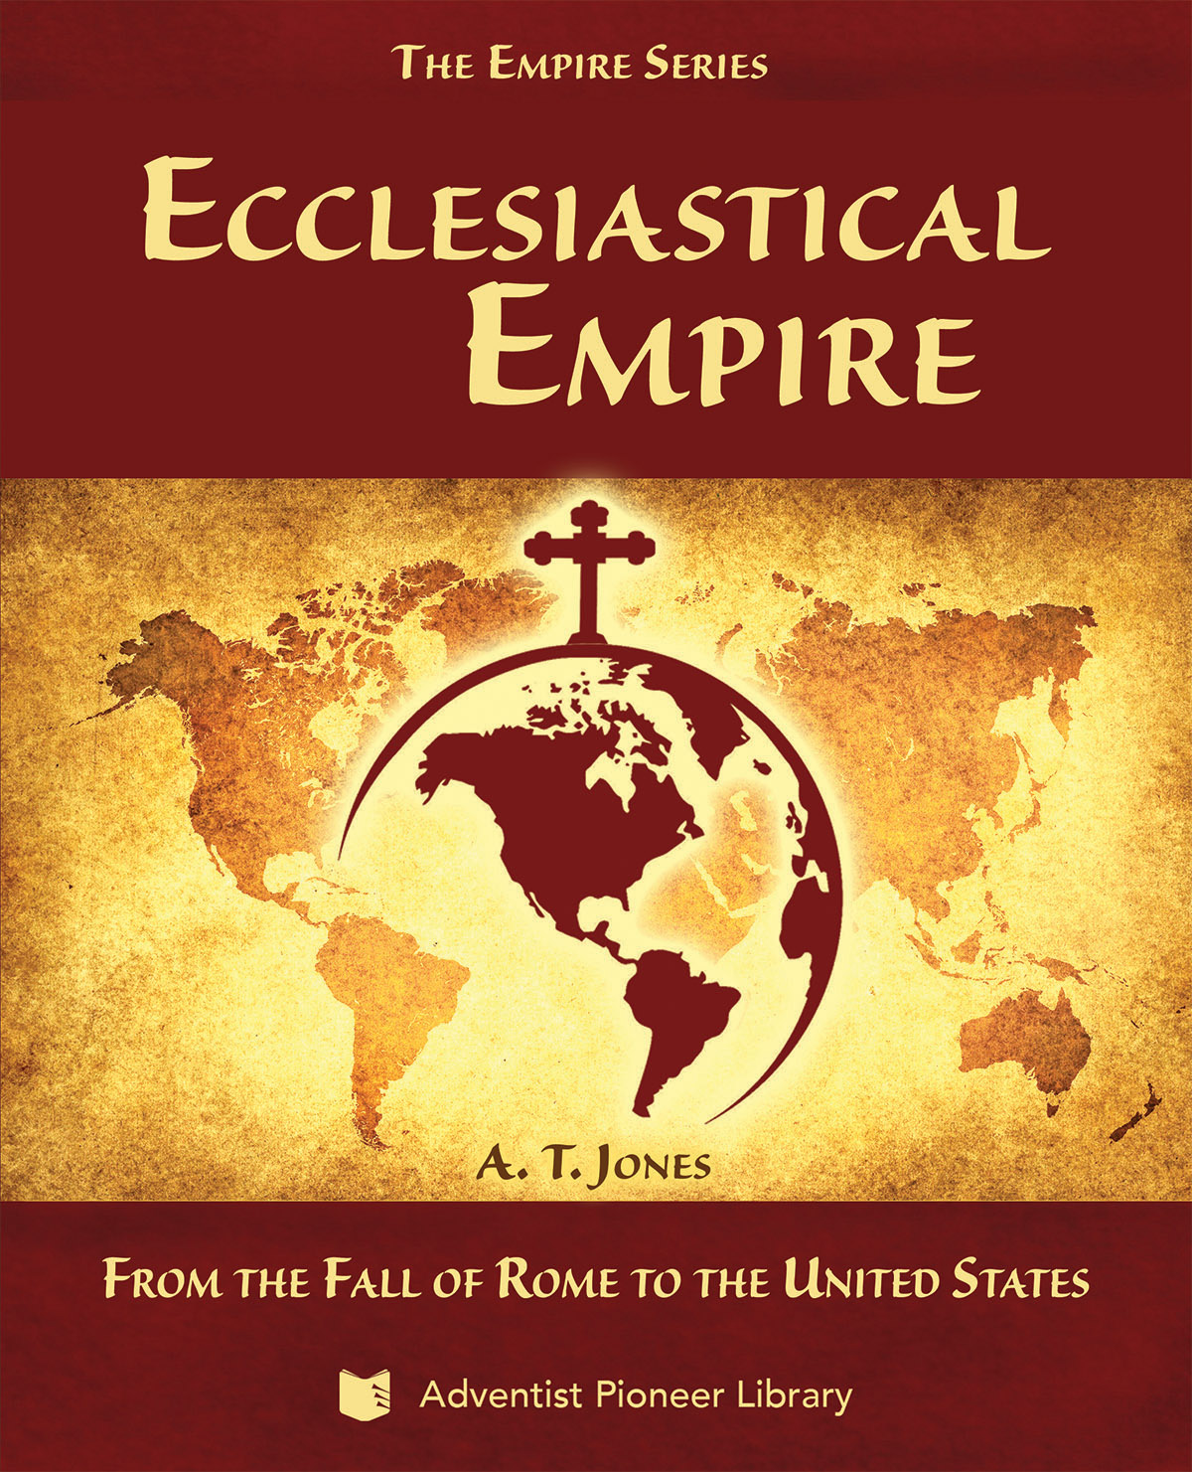
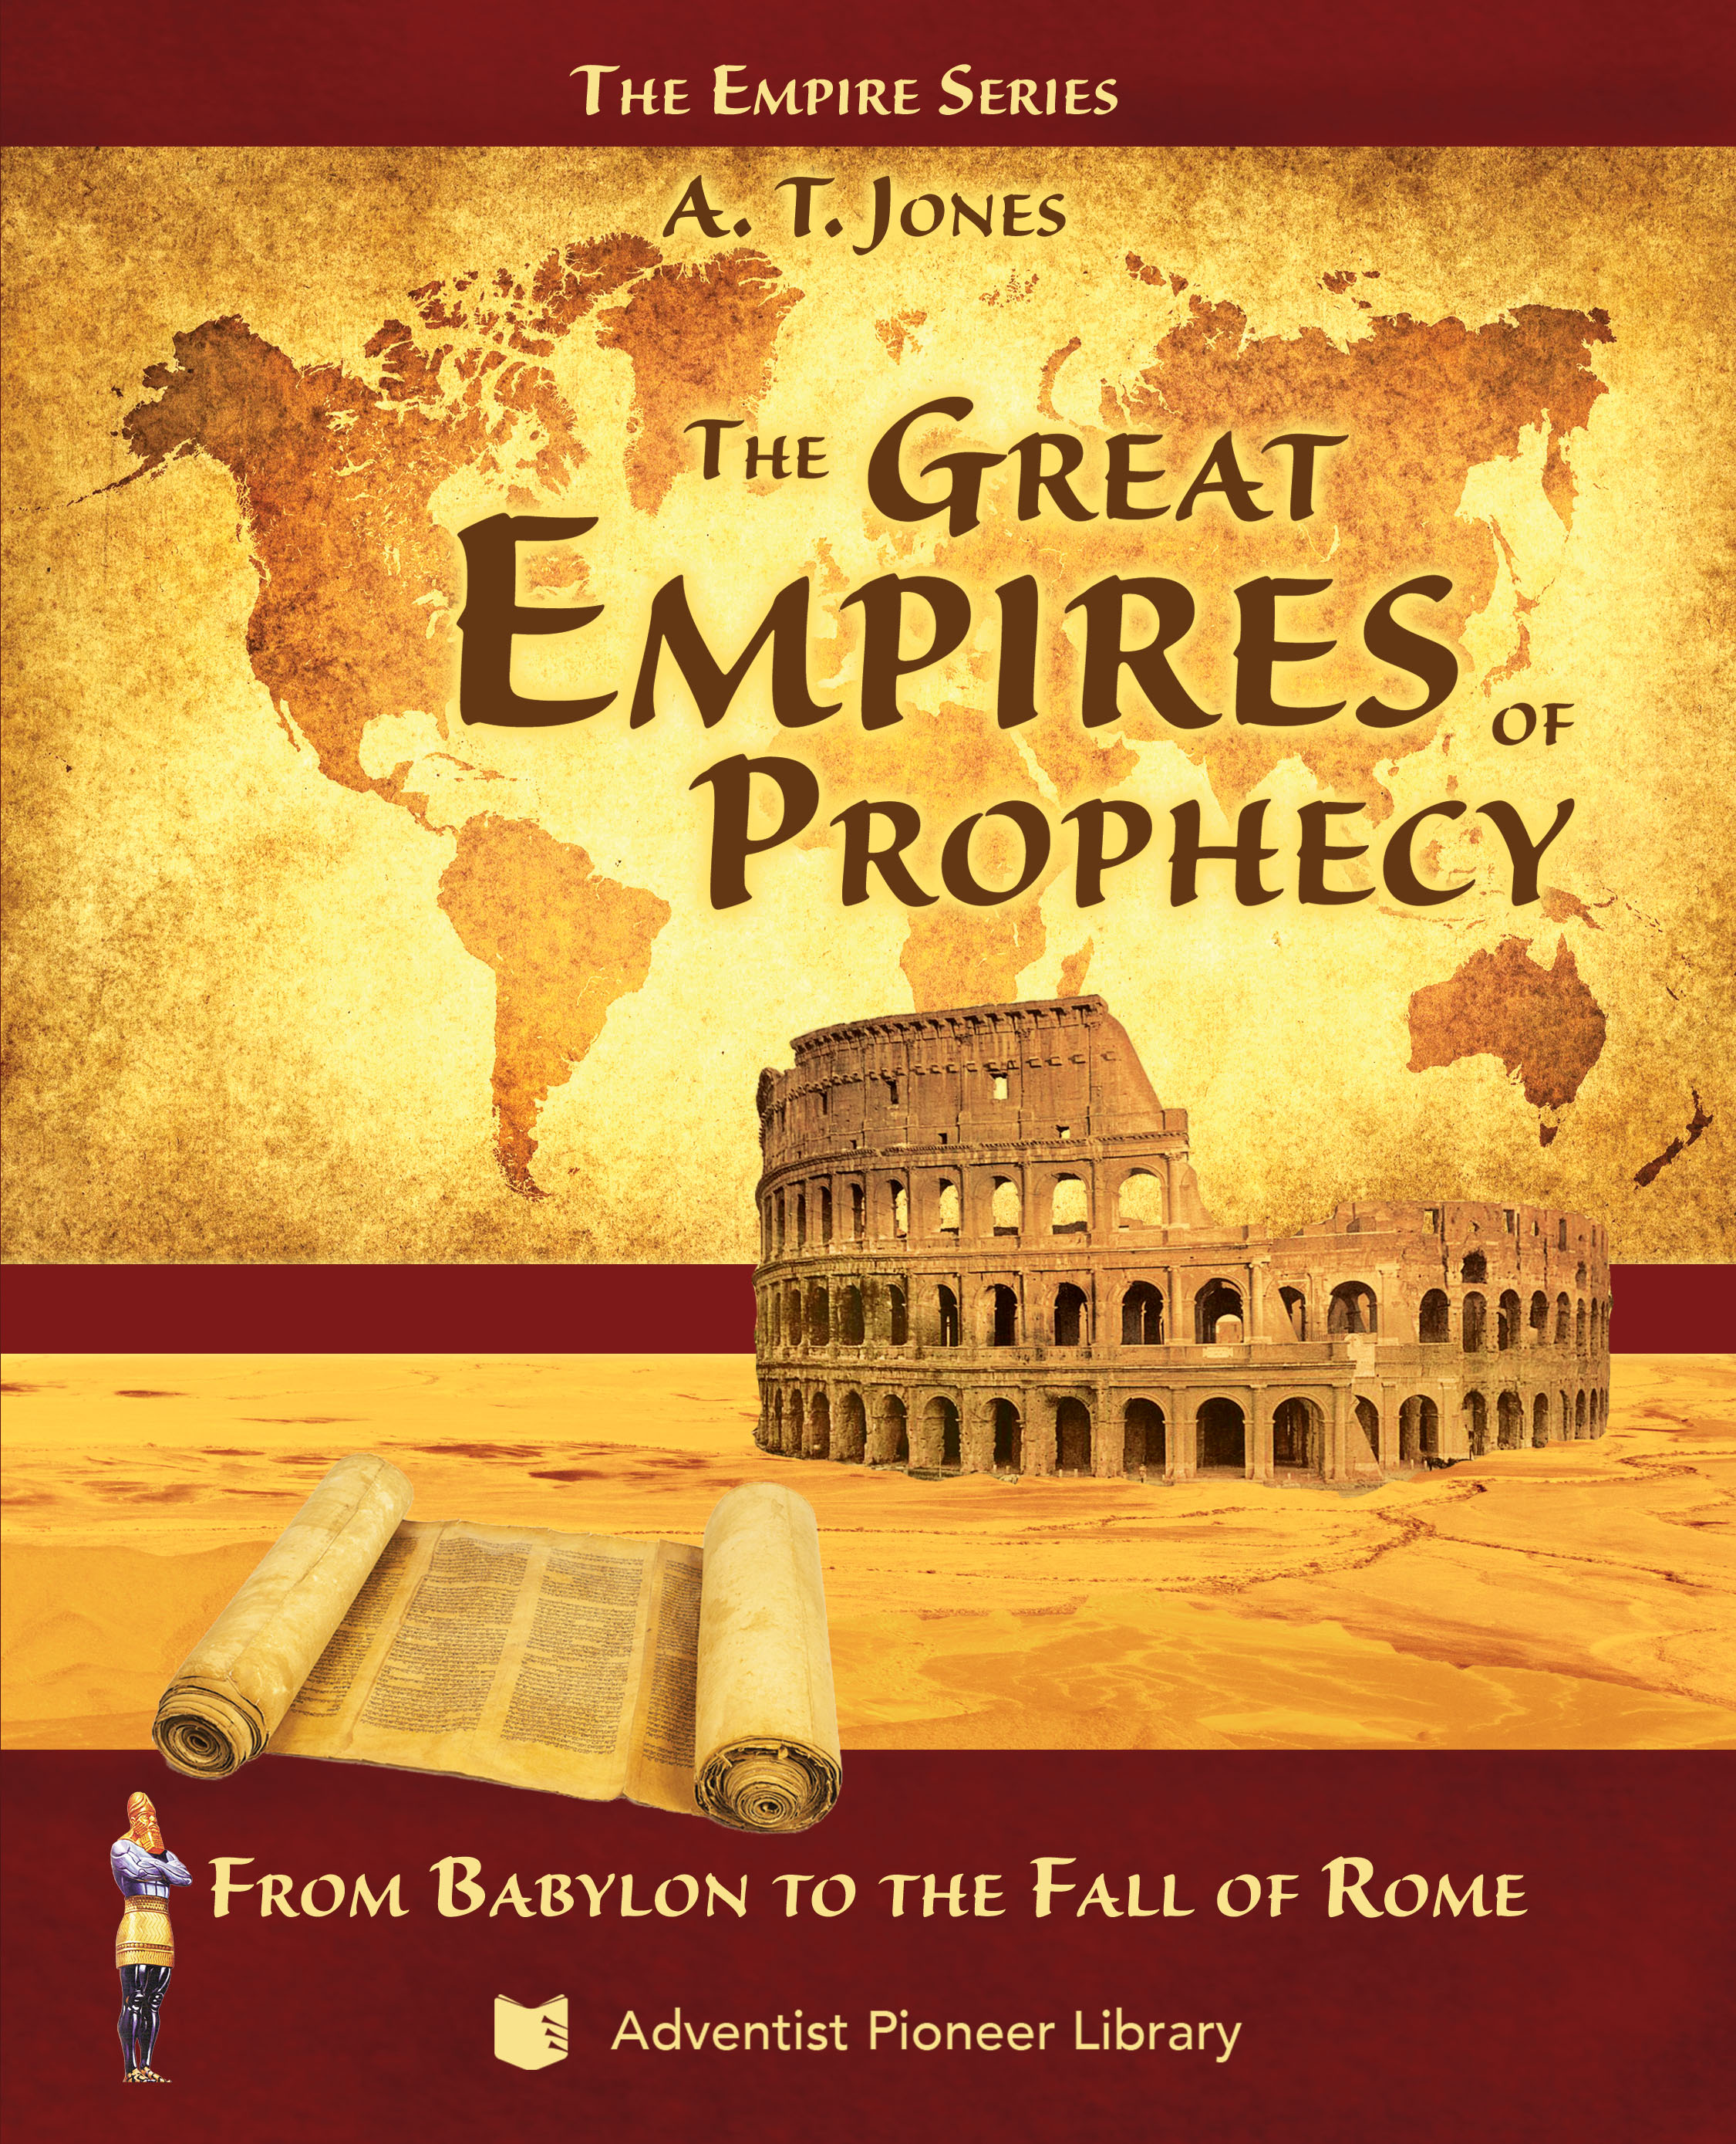
1888
A. T. Jones (1850-1923)
Converted 1874 (age 22) while in U. S. Army. Co-editor of The Signs of the Times.
Messenger of righteousness of Jesus (EGW 1888, pages 287.2; 291.1; 299.1; 1241.2 1336.2; 1455.2; 1814.4).
Article collection: Lesson on Faith republished
Books: Great Empires of Prophecy, Ecclesiastical Empire, The Third Angel’s Message (1893 General Conference Sermons)

Slide 41
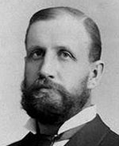
1888
W. W. Prescott (1855-1944)
Parents became Sabbath-keeping Adventists in 1858; baptized by J. N. Andrews in 1872. Battle Creek College president, 1885-1894.
Messenger of righteousness of Jesus (EGW 1888, pages 850.3; 862.1; 1241.2; 1243.1; 1455.2).
Educator, administrator, author (more later)

Slide 42
1888
Summary statements:
1895: elements of the message (“most precious”, “uplifted Saviour”, “the righteousness of Christ”, etc.), and opposition to it (EGW 1888, page 1336-1342)
1896: opposition: in a great measure Spirit’s power [Latter Rain] was shut away and prevented, and that light [Loud Cry] was resisted, has been kept away (EGW 1888, page 1575.2; also 1SM 234.6)

Slide 43
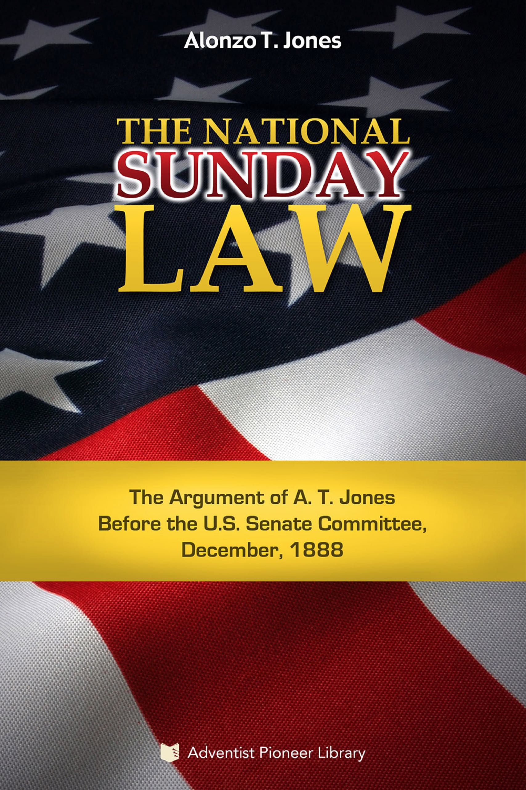
1888
See “Overview of the Advent Movement in Light of the Final Messages to the World” and “Overview of the Advent Movement Focused on the 1888 Message” under Reference section.
December: Jones testifies against a proposed national Sunday-law bill in a U. S. Senate Committee, one of many attempts to pass such a law during that time period. (See the book The National Sunday Law. Also available in both Portuguese and Spanish.)
William Farnsworth dies.

Slide 44
1889
J. H. Waggoner dies.
June 2: “Through the righteousness of Christ humanity might partake of the divine nature…. Christ is coming in power and great glory, but His coming is not such a mystery as the things to take place before that event. Man must be a partaker of the divine nature in order to stand in this evil time, when the mysteries of satanic agencies are at work. Only by the divine power united with the human can souls endure through these times of trial.” (Letter 5, 1889, to H. Miller, in EGW1888, page 332.1)

Slide 45
Summary of 1850 -1889
1850s: Publishing Ministry begins in earnest to draw a growing number in the Third Angel’s Message; the Laodicean Message begins, vital for the messengers, but misused and hindered
1860s: Organization and Health ministries begin to bring order and physical healing; efficiency and blessing for all; first indication of DELAY; Jesus still outside the door

Slide 46
Summary of 1850 -1889
1870s: Education Ministry begins to meet the needs of a new generation coming to age during the continuing DELAY; Jesus still outside the door
1880s: The death of pioneers accelerates; the Loud Cry begins, bringing the neglected Faith of Jesus prominently to the front—He is knocking more loudly, but is met with amazing opposition and unbelief, continuing the DELAY

Slide 47
Thought question
Is Jesus still knocking at your heart’s door by your saying “No” to Him in some area of your life?

