Slide 1
Righteousness in remission: damage control
Christ Our Righteousness: 6
Fred bischoff
www.Fredbischoff.com • www.aplib.org

Slide 2
Review & preview
The early years of the 1900s saw an unprecedented attack on the foundations of the movement. The root issue was selfishness with its ego battles, and the landmark that suffered the most was the cleansing of the sanctuary. Every ministry of the church was affected.

Slide 3
Review & preview
Ellen White’s focus began to address the theme we could describe as (using the construction metaphor), “If you are not going to finish the house, at least do not tear up the foundations.” She continued to point to the importance of the pioneers and the foundation work God had done in the early years.
At the same time there were exceptions, as individuals ran with the Loud Cry Message.

Slide 4
1904
May 23: Magan and Sutherland resign from Emmanuel Missionary College, and the next month with Ellen White buy the property for the Madison School in Tennessee. This will be the first educational and medical institution joining the mission not owned by the organization of the church, and the only one on whose administrative board Ellen White ever sat. (See appendices in Studies in Christian Education by E. A. Sutherland. Book also in Portuguese and Spanish. Audio in English and Portuguese at www.EllenWhiteAudio.org)

Slide 5




Slide 6
1904
July 14: Crisis: “make of no effect the truth for this time”; “not a stone is to be moved in the foundation of this truth—not a pillar moved” (Lt. 237, 1904; in Manuscript Releases, Volume 19, page 311.3)

Slide 7
1904
December 15: Ellen White's article "A Call to Repentance" is published in the The Review and Herald (based on a 1902 manuscript she wrote) in which she again applied the Laodicean Message to us. "I can not fail to see that the light which God has given me is not favorable to our ministers or our churches. You have left your first love. Self-righteousness is not the wedding-garment. A failure to follow the clear light of truth is our fearful danger. The message to the Laodicean church reveals our condition as a people." (par. 9).

Slide 8
1904
In the article she explained Christ's feelings. "In every church in our land, there is needed confession, repentance, and reconversion. The disappointment of Christ is beyond description.... Christ is humiliated in his people." (par. 8) (See Manuscript Releases, Volume 18, page 192.1&2, for 1902 manuscript.)

Slide 9
1905
Ten documents written addressing the need to reaffirm the foundations—“the fundamental principles that are based upon unquestionable authority”—reprint; repeat; reproduce; Kellogg “under Satan’s special guidance”; Ballenger “led by satanic agencies” (Manuscript Releases, Volume 10, page 45.1; Manuscript Release, Number 760, page 14.2 and 4.4; see Lest We Forget, Volume 12, Numbers 1 & 2 for extracts of these ten documents.)

Slide 10
1905
J. N. Loughborough publishes The Great Second Advent Movement, an updated version of his 1892 history book. (Also in Portuguese and Spanish; audio book available in English and Portuguese at www.EllenWhiteAudio.org.)

Slide 11
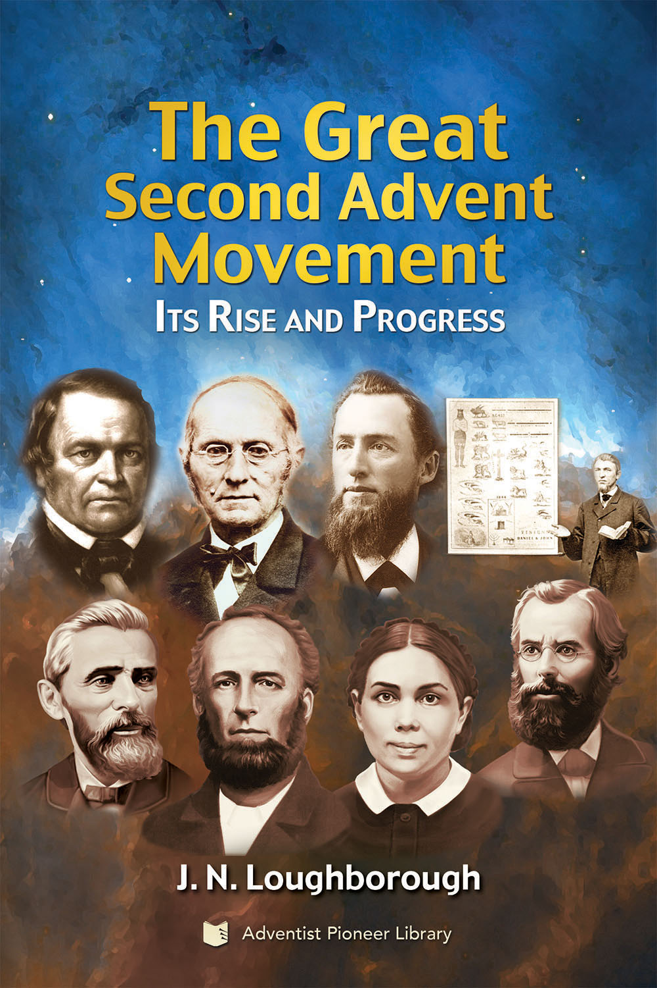
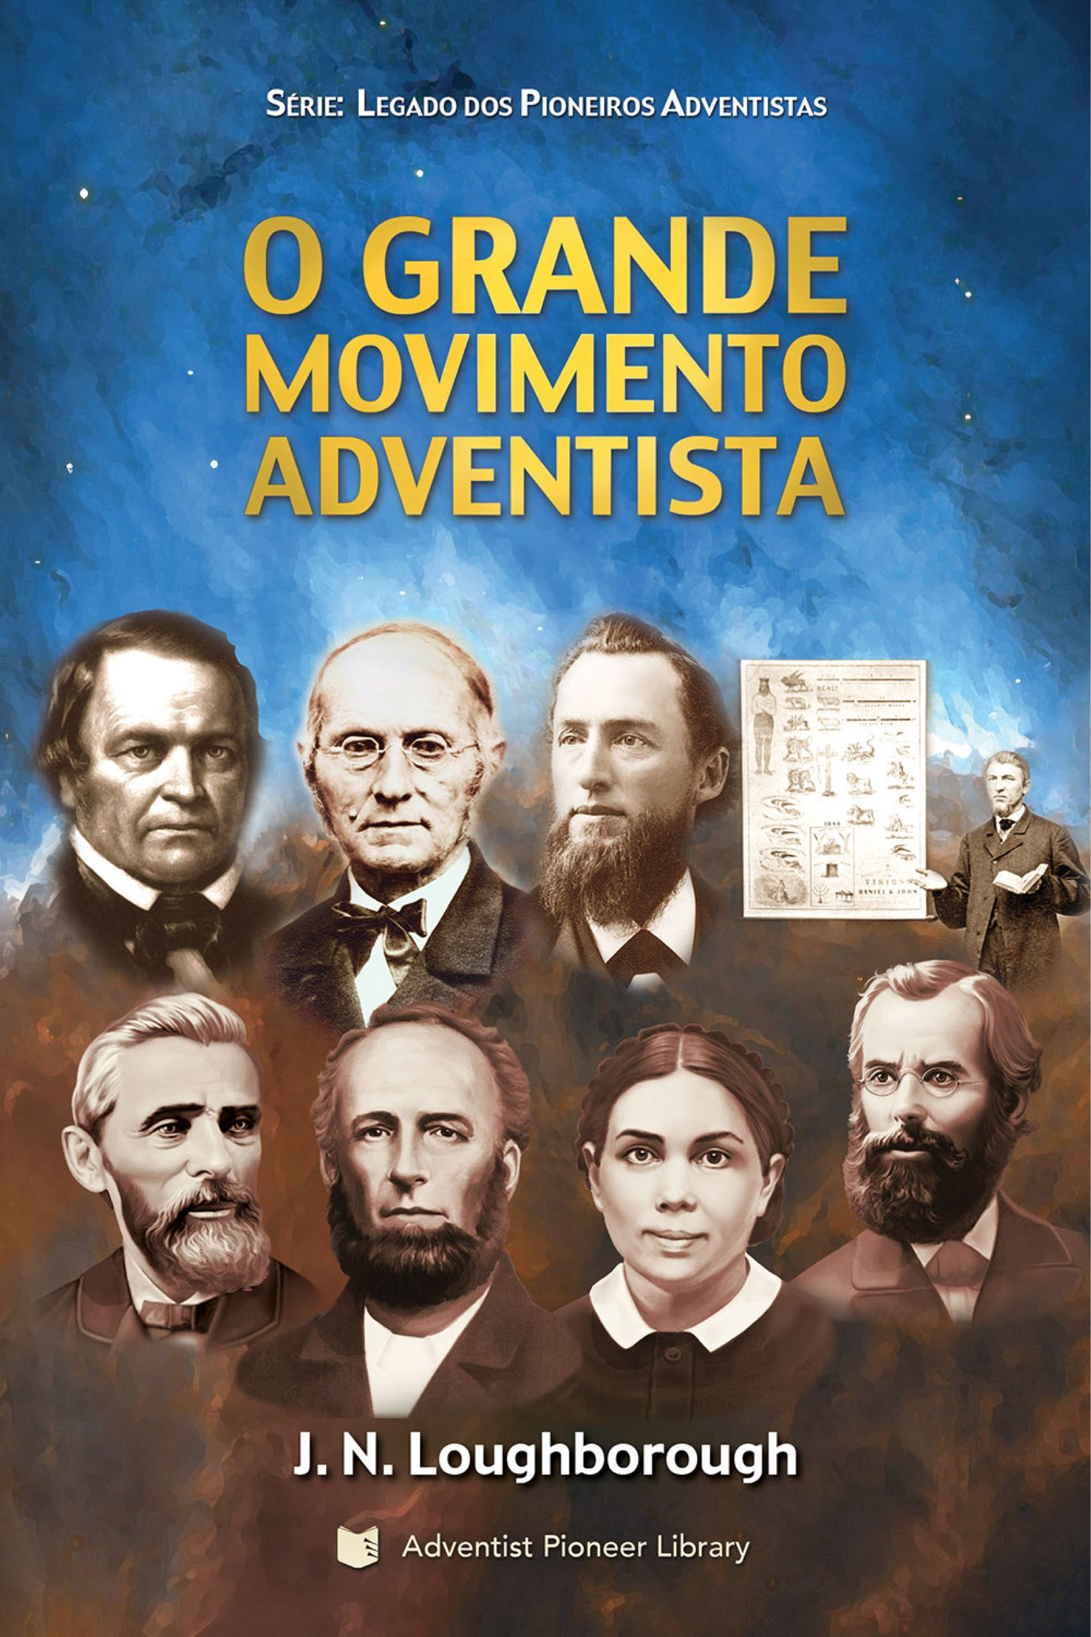
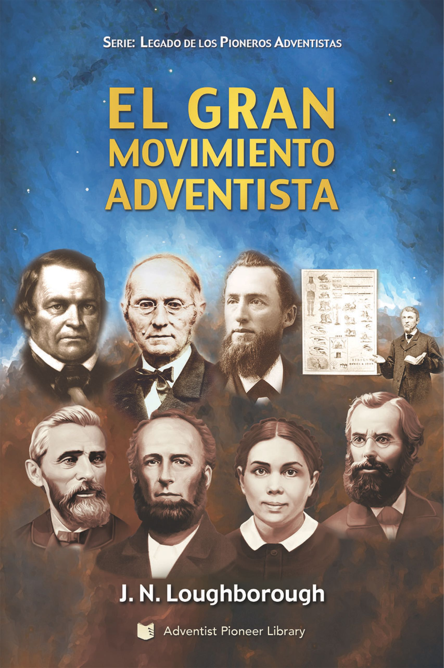

Slide 12
1906
Five documents with the continued call to “strengthen our belief in the past experience” (Lt 40, 1906; in Manuscript Release, Number 760, pages 20.4 (See Lest We Forget, Vol. 12, No. 2 for extracts of these five documents.)

Slide 13
1907
July 7: Need to “vindicate the advent message, the most important message that will ever come to the world... God bids us give our time and strength to the work of preaching to the people the messages that stirred men and women in 1843 and 1844....

Slide 14
1907
“Instead of going over and over the same ground to establish the faith of those who should never have accepted a doubt regarding the third angel's message, let our efforts be given to making known the truth to those who have never heard it. God calls upon us to make known to all men the truths that have made us what we are--Seventh-day Adventists.” (Ms. 125, 1907; in Manuscript Release, Number 760, page 30.1&2)

Slide 15
1908
March 25: Need “to publish the early experiences of the cause of present truth” (Ms. 13, 1908; in Spalding-Magan Collection, page 426.4)

Slide 16
1908
October 11: In a document titled “An Appeal to Ministers and Church Officers” Ellen White addresses the mixed picture of progress and delay during the 1890s and 1900s: “As I read the reports of labor published in the Review and our other denominational periodicals from week to week, my heart is rejoiced over the progress of the third angel's message in the home field and abroad. Our workers are having many remarkable experiences.

Slide 17
1908
“The Lord is going before them, preparing the way, and the cause of present truth is making rapid advancement. This should be a source of profound gratitude to God. As we contrast the present prosperity of the work with the early years of poverty passed through by the pioneers of this cause, when our numbers were but few and our resources were limited, we can but exclaim, ‘What hath God wrought!’

Slide 18
1908
“And yet there remains much to be done. In the past we have not been as diligent as we ought to have been in seeking to save the lost. Precious opportunities have been allowed to pass by unimproved. This has delayed the coming of our King. Had the people of God constantly preserved a living connection with Him from the beginning of the great advent movement, had they obeyed His word and advanced in all His opening providences, they would today be in the heavenly Canaan.” (Pamphlet Number 10, page 3.1&2; DELAY)

Slide 19
1908
See “Entry of Seventh-day Adventists into World Countries” under Reference Section in light of the two decades after Minneapolis.

Slide 20

1909
It appears the significant progress was fueled by individuals who had received the beginning of the Loud Cry, and it was as fire in their bones. Trace for example the gospel references in the work of these three medical missionaries:
Dr. David Paulson (1868-1916): medical missionary work in Chicago area (Footprints of Faith, pages 21-23, 63)

Slide 21
1909
Ferdinand Stahl (1874-1950): committed to work in South America in 1909 (In the Land of the Incas, pages 15, 129, 134, 136, 146, 188, 229, 271, 280, 281, 285)
  1926: in Mount Holly, New Jersey, directed Arthur and Martin Bischoff into nursing
Drs. Daniel & Lauretta Kress (1862-1956): medical missionary work in England, Australia, USA (Under the Guiding Hand, pages 64, 87-90)
  1930-33: in Takoma Park, Maryland, Martin Bischoff trained under Daniel Kress; 1950s: in Avon Park, Florida Martin would treat him

Slide 22
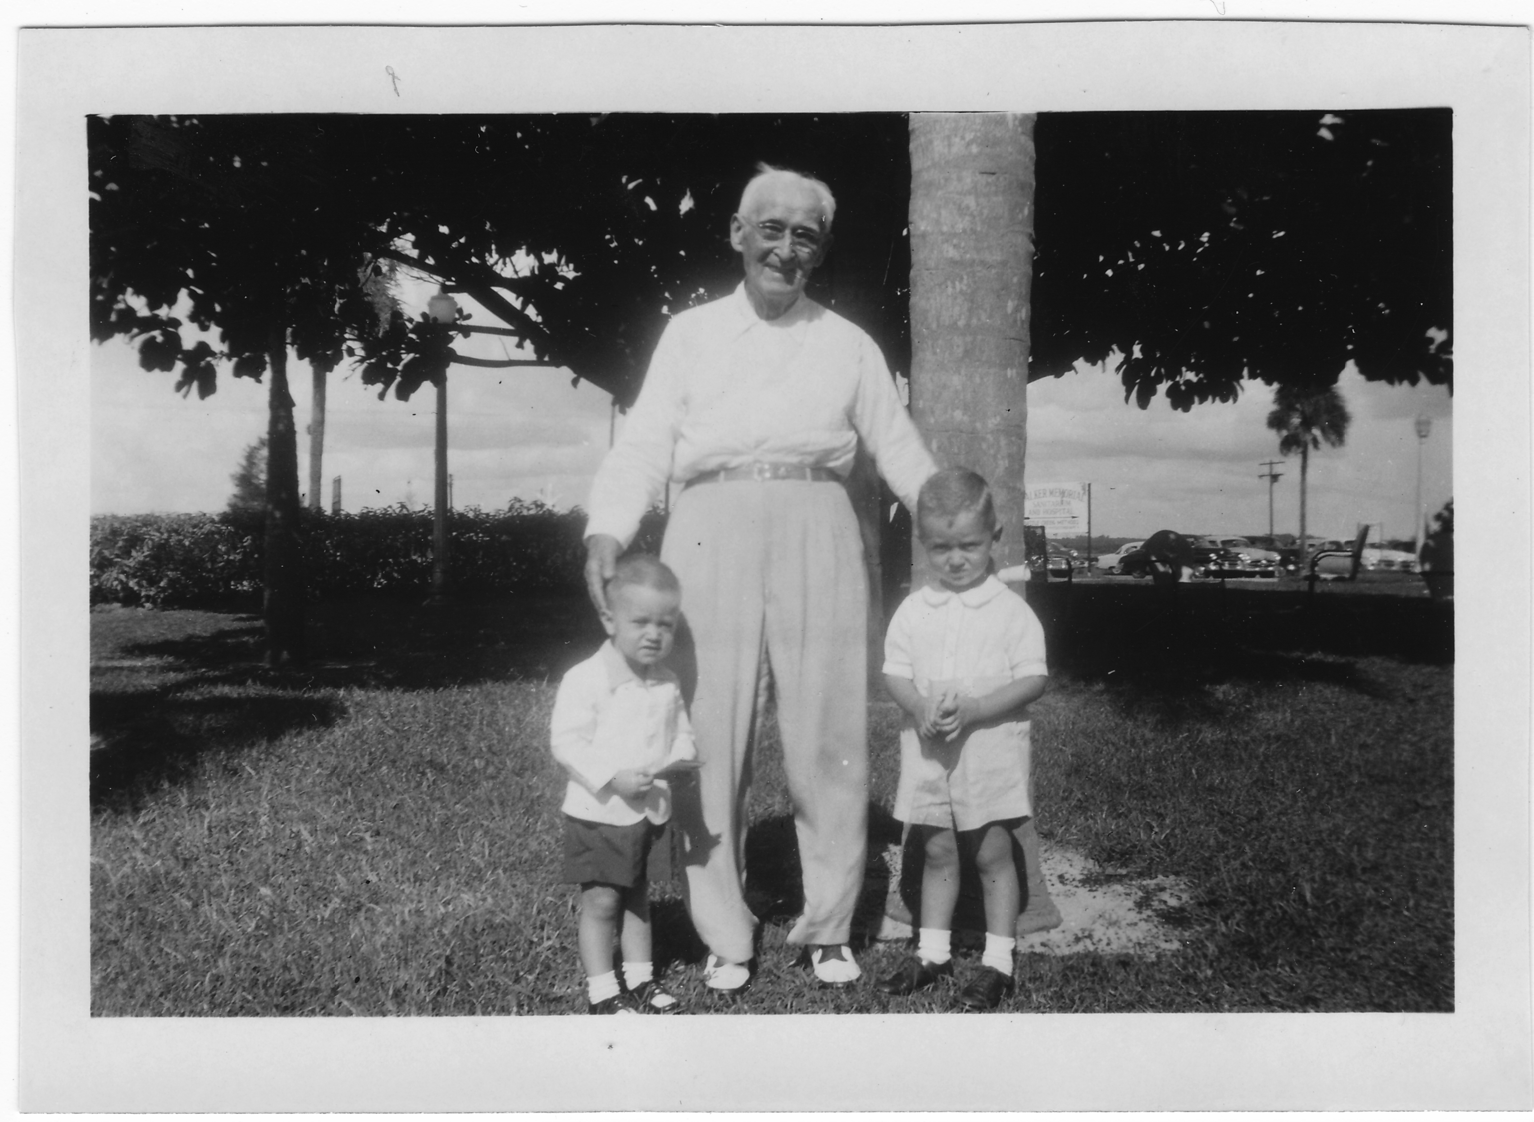
c. 1953, Dr. D. H. Kress with Tom and Fred Bischoff

Slide 23
1910
By 1910, E. J. Waggoner and A. T. Jones are out of the church, choosing to work with Dr. Kellogg who was also out of the church by then (Ellen G. White, Biography Volume 5, pages 348.4, 420.5). However, recall the September 1892 warning against the "fatal delusion” of rejecting the message if the messengers lost their way.

Slide 24
1910
M. L. Andreasen visits Ellen White at Elmshaven to check on portions of her writings he was sure she had not written. He becomes convinced of the divine origin of this gift of the testimony of Jesus. (Without Fear or Favor, Virginia Steinweg, pages 73-78).

Slide 25
1910
“The messages which the Lord gave us in the past are very important at this stage of the earth’s history.” (Lt. 130, 1910; in EGW1888, pages 1811.4)

Slide 26
Summary thoughts on the delay
The response to the messages causes the delay.
  Unbelief can be manifested by refusing the practical application of the messages.
  One cannot give what one does not have.
  An imbalance in the landmarks causes the message to be marred in our hands. (See EGW1888, page 367.1)

Slide 27
Summary thoughts on the delay
The importance of our history increases as the delay increases.
  There is increasing need to explain what has happened, and explain the evidences for the delay.
  The question of God’s leading becomes vital.
  Those things that “know no haste and no delay” (Desire of Ages, page 32.1) need to be differentiated clearly from those that properly answer such a question as, “Why has the Lord so long delayed his coming?” (Review and Herald, March 27, 1894, paragraph 14), and that carefully unwrap titles like “Why the Lord Waits” (Review and Herald, July 21, 1896).

Slide 28
Thought question
What can you do to cooperate with God to end the delay?

